Slide 1


Decision Tree: Information Gain

Slide 2
Decision Tree
Basic algorithm (a greedy algorithm)
Tree is constructed in a top-down recursive divide-and-conquer manner
At start, all the training examples are at the root
Attributes are categorical (if continuous-valued, they are discretized in advance)
Examples are partitioned recursively based on selected attributes
Test attributes are selected on the basis of a heuristic or statistical measure (e.g., information gain)

Slide 3
Decision Tree: Information Gain
Sl. No. | Outlook | Temp | Humidity | Windy | Play Golf
1 | Rainy | Hot | High | Weak | No
2 | Rainy | Hot | High | Strong | No
3 | Overcast | Hot | High | Weak | Yes
4 | Sunny | Mild | High | Weak | Yes
5 | Sunny | Cool | Normal | Weak | Yes
6 | Sunny | Cool | Normal | Strong | No
7 | Overcast | Cool | Normal | Strong | Yes
8 | Rainy | Mild | High | Weak | No
9 | Rainy | Cool | Normal | Weak | Yes
10 | Sunny | Mild | Normal | Weak | Yes
11 | Rainy | Mild | Normal | Strong | Yes
12 | Overcast | Mild | High | Strong | Yes
13 | Overcast | Hot | Normal | Weak | Yes
14 | Sunny | Mild | High | Strong | No

Slide 4
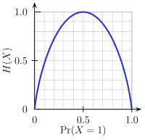



Decision Tree: Information Gain

Slide 5
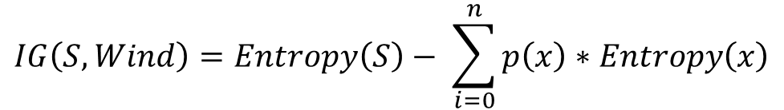
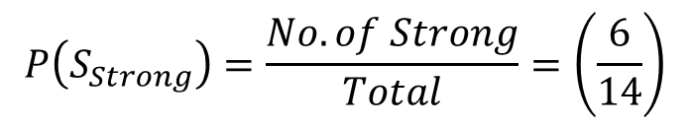
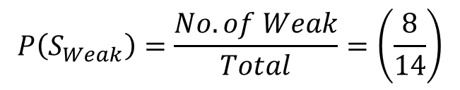
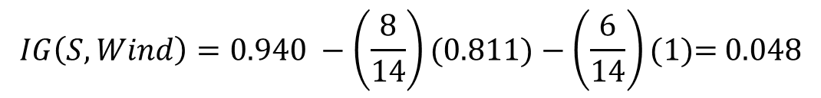
$Entropy\left(S\right)=−\left(\frac{9}{14}\right)\log_{2}\left(\frac{9}{14}\right)−\left(\frac{5}{14}\right)\log_{2}\left(\frac{5}{14}\right)$ = 0.940
Wind
 | Yes | No
Weak | 6 | 2
Strong | 3 | 3
Total | 9 | 5
$$P\left(S_{Weak}\right)=\frac{No. of Weak}{Total}=\left(\frac{8}{14}\right)$$
$$P\left(S_{Strong}\right)=\frac{No. of Strong}{Total}=\left(\frac{6}{14}\right)$$
$Entropy\left(S_{Weak}\right)=−\left(\frac{6}{8}\right)\log_{2}\left(\frac{6}{8}\right)−\left(\frac{2}{8}\right)\log_{2}\left(\frac{2}{8}\right)$ = 0.811
$Entropy\left(S_{Strong}\right)=−\left(\frac{3}{6}\right)\log_{2}\left(\frac{3}{6}\right)−\left(\frac{3}{6}\right)\log_{2}\left(\frac{3}{6}\right)$ = 1
$$IG\left(S, Wind\right)=Entropy\left(S\right)− \sum_{i=0}^{n}{p\left(x\right)∗Entropy\left(x\right)}$$
$$IG\left(S, Wind\right)=Entropy\left(S\right) − P\left(S_{Weak}\right)\text{ ∗ }Entropy\left(Weak\right) − P\left(S_{Strong}\right)\text{ ∗ }Entropy(Strong)$$
$$IG\left(S, Wind\right)=0.940 −\left(\frac{8}{14}\right)(0.811)−\left(\frac{6}{14}\right)(1)\text{= }\text{0.048}$$

Slide 6

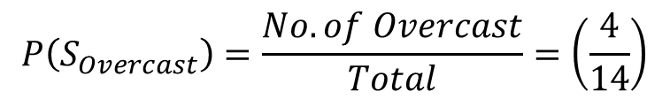
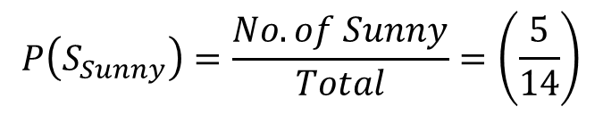
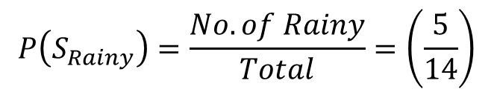
$$P\left(S_{Sunny}\right)=\frac{No. of Sunny}{Total}=\left(\frac{5}{14}\right)$$
Overcast
 | Yes | No
Sunny | 3 | 2
Overcast | 4 | 0
Rainy | 2 | 3
Total | 9 | 5
$$P\left(S_{Overcast}\right)=\frac{No. of Overcast}{Total}=\left(\frac{4}{14}\right)$$
$$P\left(S_{Rainy}\right)=\frac{No. of Rainy}{Total}=\left(\frac{5}{14}\right)$$
$$Entropy\left(S_{Sunny}\right)=−\left(\frac{3}{5}\right)\log_{2}\left(\frac{3}{5}\right)−\left(\frac{2}{5}\right)\log_{2}\left(\frac{2}{5}\right)=0.970951$$
$Entropy\left(S\right)=$ 0.940
$Entropy\left(S_{Overcast}\right)=−\left(\frac{4}{4}\right)\log_{2}\left(\frac{4}{4}\right)−\left(\frac{0}{4}\right)\log_{2}\left(\frac{0}{4}\right)$ = Undefined(Kindly consider it as Zero)
$$Entropy\left(S_{Rainy}\right)=−\left(\frac{2}{5}\right)\log_{2}\left(\frac{2}{5}\right)−\left(\frac{3}{5}\right)\log_{2}\left(\frac{3}{5}\right)=0.970951$$
$IG\left(S, Overcast\right)=Entropy\left(S\right) − P\left(S_{Sunny}\right)\text{ ∗ }Entropy\left(Sunny\right) − P\left(S_{Overcast}\right)\text{ ∗ }Entropy(Overcast)$ $− P\left(S_{Rainy}\right)\text{ ∗ }Entropy(Rainy)$
$$IG\left(S, Overcast\right)=0.940 −\left(\frac{5}{14}\right)\left(0.970951\right)−\left(\frac{4}{14}\right)\left(0\right)−\left(\frac{5}{14}\right)(0.970951)\text{= }\text{0.0246}$$

Slide 7

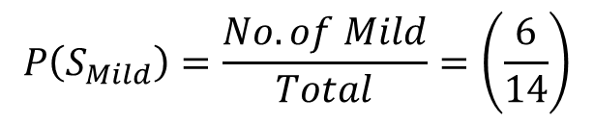
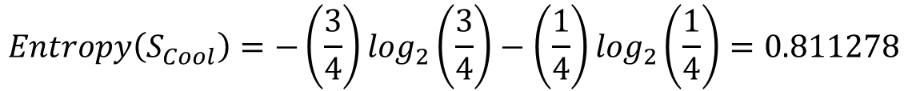
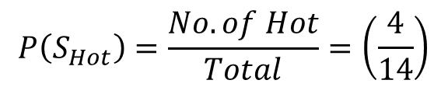
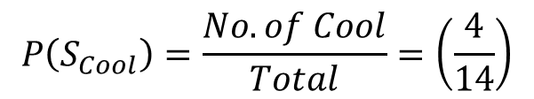
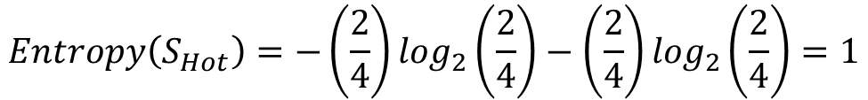
$$P\left(S_{Hot}\right)=\frac{No. of Hot}{Total}=\left(\frac{4}{14}\right)$$
Temperature
 | Yes | No
Hot | 2 | 2
Mild | 4 | 2
Cool | 3 | 1
Total | 9 | 5
$$P\left(S_{Mild}\right)=\frac{No. of Mild}{Total}=\left(\frac{6}{14}\right)$$
$$P\left(S_{Cool}\right)=\frac{No. of Cool}{Total}=\left(\frac{4}{14}\right)$$
$Entropy\left(S\right)=$ 0.940
$$Entropy\left(S_{Hot}\right)=−\left(\frac{2}{4}\right)\log_{2}\left(\frac{2}{4}\right)−\left(\frac{2}{4}\right)\log_{2}\left(\frac{2}{4}\right)=1$$
$Entropy\left(S_{Mild}\right)=−\left(\frac{4}{6}\right)\log_{2}\left(\frac{4}{6}\right)−\left(\frac{2}{6}\right)\log_{2}\left(\frac{2}{6}\right)$ = 0.918296
$$Entropy\left(S_{Cool}\right)=−\left(\frac{3}{4}\right)\log_{2}\left(\frac{3}{4}\right)−\left(\frac{1}{4}\right)\log_{2}\left(\frac{1}{4}\right)=0.811278$$
$IG\left(S, Temp\right)=Entropy\left(S\right) − P\left(S_{Hot}\right)\text{ ∗ }Entropy\left(Hot\right) − P\left(S_{Mild}\right)\text{ ∗ }Entropy(Mild)$ $− P\left(S_{Cool}\right)\text{ ∗ }Entropy(Cool)$
$$IG\left(S, Temp\right)=0.940 −\left(\frac{4}{14}\right)\left(\text{1} \right)−\left(\frac{6}{14}\right)\left(\text{0.918296}\right)−\left(\frac{4}{14}\right)(0.811278) \text{=}\text{ 0.028937}$$

Slide 8
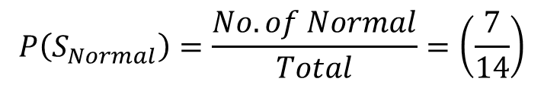
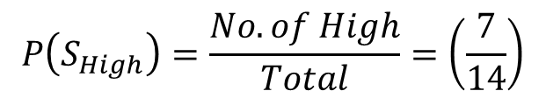

Humidity
 | Yes | No
High | 3 | 4
Normal | 6 | 1
Total | 9 | 5
$$P\left(S_{High}\right)=\frac{No. of High}{Total}=\left(\frac{7}{14}\right)$$
$$P\left(S_{Normal}\right)=\frac{No. of Normal}{Total}=\left(\frac{7}{14}\right)$$
$Entropy\left(S_{High}\right)=−\left(\frac{3}{7}\right)\log_{2}\left(\frac{3}{7}\right)−\left(\frac{4}{7}\right)\log_{2}\left(\frac{4}{7}\right)$ = 0.985228
$Entropy\left(S\right)=$ 0.940
$Entropy\left(S_{Normal}\right)=−\left(\frac{6}{7}\right)\log_{2}\left(\frac{6}{7}\right)−\left(\frac{1}{7}\right)\log_{2}\left(\frac{1}{7}\right)=0.591673$
$$IG\left(S, Humidity\right)=Entropy\left(S\right) − P\left(S_{High}\right)\text{ ∗ }Entropy\left(High\right) − P\left(S_{Normal}\right)\text{ ∗ }Entropy(Normal)$$
$$IG\left(S, Humidity\right)=0.940 −\left(\frac{7}{14}\right)(\text{0.985228})−\left(\frac{7}{14}\right)(0.591673)\text{= }\text{0.151}$$

Slide 9




Decision Tree: Information Gain
$$IG\left(S, Overcast\right)=\text{0.246}$$
Highest Information Gain
Shall be selected as Root Node
$$IG\left(S, Temp\right)=\text{0.029}$$
$$IG\left(S, Wind\right) \text{= }\text{0.048}$$
Outlook
$$IG\left(S, Humidity\right)=\text{0.151}$$
Sunny
Rainy
Yes

Slide 10
Decision Tree: Gini Index
Sunny
Sl. No. | Outlook | Temp | Humidity | Windy | Play Golf
1 | Rainy | Hot | High | Weak | No
2 | Rainy | Hot | High | Strong | No
3 | Overcast | Hot | High | Weak | Yes
4 | Sunny | Mild | High | Weak | Yes
5 | Sunny | Cool | Normal | Weak | Yes
6 | Sunny | Cool | Normal | Strong | No
7 | Overcast | Cool | Normal | Strong | Yes
8 | Rainy | Mild | High | Weak | No
9 | Rainy | Cool | Normal | Weak | Yes
10 | Sunny | Mild | Normal | Weak | Yes
11 | Rainy | Mild | Normal | Strong | Yes
12 | Overcast | Mild | High | Strong | Yes
13 | Overcast | Hot | Normal | Weak | Yes
14 | Sunny | Mild | High | Strong | No
Sl. No. | Temp | Humidity | Windy | Play Golf
1 | Mild | High | Weak | Yes
2 | Cool | Normal | Weak | Yes
3 | Cool | Normal | Strong | No
4 | Mild | Normal | Weak | Yes
5 | Mild | High | Strong | No
Rainy
Sl. No. | Temp | Humidity | Windy | Play Golf
1 | Hot | High | Weak | No
2 | Hot | High | Strong | No
3 | Mild | High | Weak | No
4 | Cool | Normal | Weak | Yes
5 | Mild | Normal | Strong | Yes

Slide 11
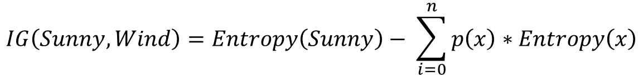
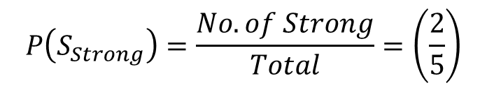
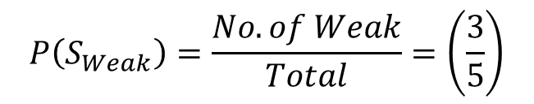
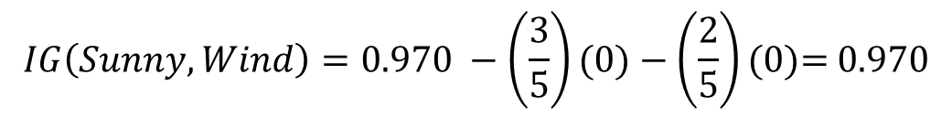
$Entropy\left(Sunny\right)=−\left(\frac{3}{5}\right)\log_{2}\left(\frac{3}{5}\right)−\left(\frac{2}{5}\right)\log_{2}\left(\frac{2}{5}\right)$ = 0.970
Wind
 | Yes | No
Weak | 3 | 0
Strong | 0 | 2
Total | 3 | 2
$$P\left(S_{Weak}\right)=\frac{No. of Weak}{Total}=\left(\frac{3}{5}\right)$$
$$P\left(S_{Strong}\right)=\frac{No. of Strong}{Total}=\left(\frac{2}{5}\right)$$
$Entropy\left(S_{Weak}\right)=−\left(\frac{3}{3}\right)\log_{2}\left(\frac{3}{3}\right)−\left(\frac{0}{0}\right)\log_{2}\left(\frac{0}{0}\right)$ = 0
$Entropy\left(S_{Strong}\right)=−\left(\frac{0}{0}\right)\log_{2}\left(\frac{0}{0}\right)−\left(\frac{2}{2}\right)\log_{2}\left(\frac{2}{2}\right)$ = 0
$$IG\left(Sunny, Wind\right)=Entropy\left(Sunny\right)− \sum_{i=0}^{n}{p\left(x\right)∗Entropy\left(x\right)}$$
$$IG\left(Sunny, Wind\right)=Entropy\left(S\right) − P\left(S_{Weak}\right)\text{ ∗ }Entropy\left(Weak\right) − P\left(S_{Strong}\right)\text{ ∗ }Entropy(Strong)$$
$$IG\left(Sunny, Wind\right)=0.970 −\left(\frac{3}{5}\right)(0)−\left(\frac{2}{5}\right)(0)\text{= }\text{0.970}$$

Slide 12
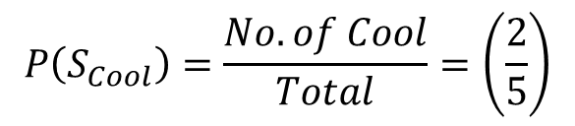

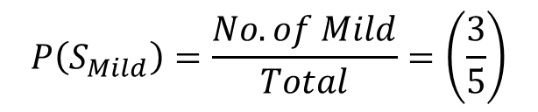
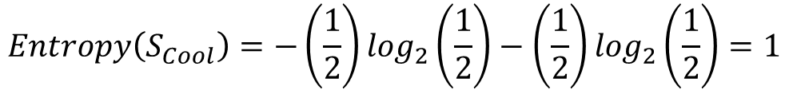
$$P\left(S_{Mild}\right)=\frac{No. of Mild}{Total}=\left(\frac{3}{5}\right)$$
Temperature
 | Yes | No
Mild | 2 | 1
Cool | 1 | 1
Total | 3 | 2
$$P\left(S_{Cool}\right)=\frac{No. of Cool}{Total}=\left(\frac{2}{5}\right)$$
$Entropy\left(S\right)=$ 0.970
$Entropy\left(S_{Mild}\right)=−\left(\frac{2}{3}\right)\log_{2}\left(\frac{2}{3}\right)−\left(\frac{1}{3}\right)\log_{2}\left(\frac{1}{3}\right)$ = 0.88975
$$Entropy\left(S_{Cool}\right)=−\left(\frac{1}{2}\right)\log_{2}\left(\frac{1}{2}\right)−\left(\frac{1}{2}\right)\log_{2}\left(\frac{1}{2}\right)=1$$
$IG\left(Sunny, Temp\right)=Entropy\left(S\right) − P\left(S_{Mild}\right)\text{ ∗ }Entropy(Mild)$ $− P\left(S_{Cool}\right)\text{ ∗ }Entropy(Cool)$
$$IG\left(Sunny, Temp\right)=0.970 −\left(\frac{3}{5}\right)\left(\text{0.88975}\right)−\left(\frac{2}{5}\right)\left(\text{1}\right) \text{=}\text{ 0.036966}$$

Slide 13
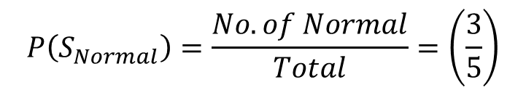
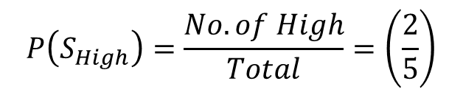

$$P\left(S_{High}\right)=\frac{No. of High}{Total}=\left(\frac{2}{5}\right)$$
Humidity
 | Yes | No
High | 1 | 1
Normal | 2 | 1
Total | 3 | 2
$$P\left(S_{Normal}\right)=\frac{No. of Normal}{Total}=\left(\frac{3}{5}\right)$$
$Entropy\left(S_{High}\right)=−\left(\frac{1}{2}\right)\log_{2}\left(\frac{1}{2}\right)−\left(\frac{1}{2}\right)\log_{2}\left(\frac{1}{2}\right)$ = 1
$Entropy\left(S\right)=$ 0.970
$Entropy\left(S_{Normal}\right)=−\left(\frac{2}{3}\right)\log_{2}\left(\frac{2}{3}\right)−\left(\frac{1}{3}\right)\log_{2}\left(\frac{1}{3}\right)=0.591673$
$$IG\left(Sunny, Humidity\right)=Entropy\left(S\right) − P\left(S_{High}\right)\text{ ∗ }Entropy\left(High\right) − P\left(S_{Normal}\right)\text{ ∗ }Entropy(Normal)$$
$$IG\left(Sunny, Humidity\right)=0.970 −\left(\frac{2}{5}\right)(\text{1})−\left(\frac{3}{5}\right)(0.591673)\text{= }\text{0.014961}$$

Slide 14



Decision Tree: Information Gain
Highest Information Gain
Shall be selected as Root Node
$$IG\left(Sunny, Wind\right)=\text{0.970}$$
Outlook
$$IG\left(Sunny, Humidity\right)=\text{0.014961}$$
$$IG\left(Sunny, Temp\right)=\text{0.036966}$$
Sunny
Rainy
Windy
Yes
Weak
Strong
Yes
No

Slide 15
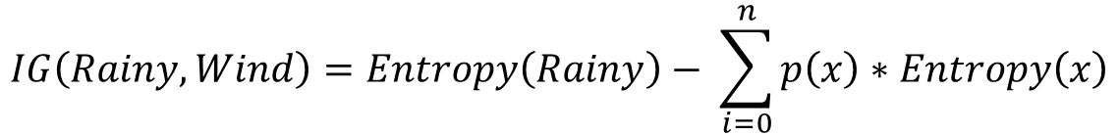
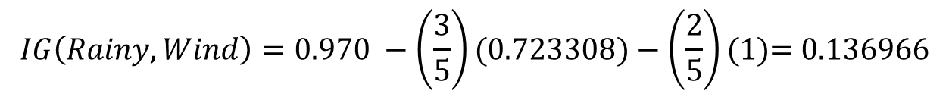
$Entropy\left(Rainy\right)=−\left(\frac{3}{5}\right)\log_{2}\left(\frac{3}{5}\right)−\left(\frac{2}{5}\right)\log_{2}\left(\frac{2}{5}\right)$ = 0.970
Wind
 | Yes | No
Weak | 1 | 2
Strong | 1 | 1
Total | 2 | 3
$$P\left(S_{Weak}\right)=\frac{No. of Weak}{Total}=\left(\frac{3}{5}\right)$$
$$P\left(S_{Strong}\right)=\frac{No. of Strong}{Total}=\left(\frac{2}{5}\right)$$
$Entropy\left(S_{Weak}\right)=−\left(\frac{1}{3}\right)\log_{2}\left(\frac{1}{3}\right)−\left(\frac{2}{3}\right)\log_{2}\left(\frac{2}{3}\right)$ = 0.723308
$Entropy\left(S_{Strong}\right)=−\left(\frac{1}{2}\right)\log_{2}\left(\frac{1}{2}\right)−\left(\frac{1}{2}\right)\log_{2}\left(\frac{1}{2}\right)$ = 1
$$IG\left(Rainy, Wind\right)=Entropy\left(Rainy\right)− \sum_{i=0}^{n}{p\left(x\right)∗Entropy\left(x\right)}$$
$$IG\left(Rainy, Wind\right)=Entropy\left(S\right) − P\left(S_{Weak}\right)\text{ ∗ }Entropy\left(Weak\right) − P\left(S_{Strong}\right)\text{ ∗ }Entropy(Strong)$$
$$IG\left(Rainy, Wind\right)=0.970 −\left(\frac{3}{5}\right)(\text{0.723308})−\left(\frac{2}{5}\right)(1)\text{= }\text{0.136966}$$

Slide 16
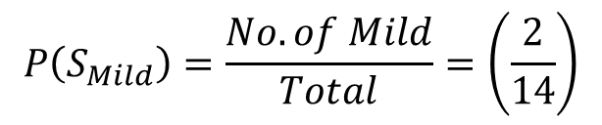
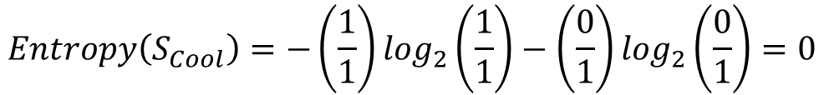
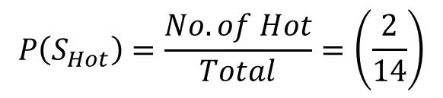
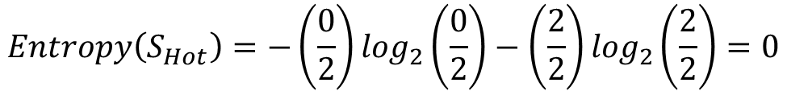
$$P\left(S_{Hot}\right)=\frac{No. of Hot}{Total}=\left(\frac{2}{14}\right)$$
Temperature
 | Yes | No
Hot | 0 | 2
Mild | 1 | 1
Cool | 1 | 0
Total | 2 | 3
$$P\left(S_{Mild}\right)=\frac{No. of Mild}{Total}=\left(\frac{2}{14}\right)$$
$$P\left(S_{Cool}\right)=\frac{No. of Cool}{Total}=\left(\frac{4}{14}\right)$$
$Entropy\left(S\right)=$ 0.970
$$Entropy\left(S_{Hot}\right)=−\left(\frac{0}{2}\right)\log_{2}\left(\frac{0}{2}\right)−\left(\frac{2}{2}\right)\log_{2}\left(\frac{2}{2}\right)=0$$
$Entropy\left(S_{Mild}\right)=−\left(\frac{1}{2}\right)\log_{2}\left(\frac{1}{2}\right)−\left(\frac{1}{2}\right)\log_{2}\left(\frac{1}{2}\right)$ = 1
$$Entropy\left(S_{Cool}\right)=−\left(\frac{1}{1}\right)\log_{2}\left(\frac{1}{1}\right)−\left(\frac{0}{1}\right)\log_{2}\left(\frac{0}{1}\right)=0$$
$IG\left(S, Temp\right)=Entropy\left(S\right) − P\left(S_{Hot}\right)\text{ ∗ }Entropy\left(Hot\right) − P\left(S_{Mild}\right)\text{ ∗ }Entropy(Mild)$ $− P\left(S_{Cool}\right)\text{ ∗ }Entropy(Cool)$
$$IG\left(S, Temp\right)=0.970 −\left(\frac{2}{14}\right)\left(\text{0}\right)−\left(\frac{2}{14}\right)\left(\text{1}\right)−\left(\frac{1}{14}\right)(0) \text{=}\text{ 0.828093}$$

Slide 17
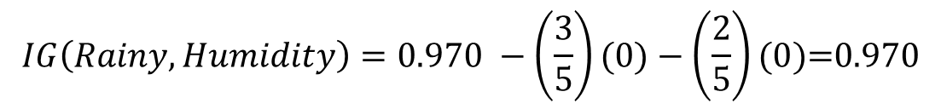
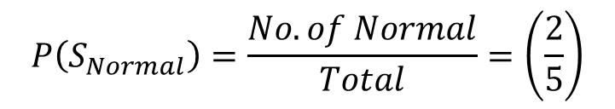
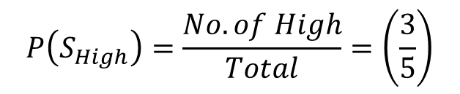
$$P\left(S_{High}\right)=\frac{No. of High}{Total}=\left(\frac{3}{5}\right)$$
Humidity
 | Yes | No | Count | P(No)
High | 0 | 3 | 3 | 4/5
Normal | 2 | 0 | 2 | 1/5
Total | 2 | 3 | 100% | 100%
$$P\left(S_{Normal}\right)=\frac{No. of Normal}{Total}=\left(\frac{2}{5}\right)$$
$Entropy\left(S_{High}\right)=−\left(\frac{0}{3}\right)\log_{2}\left(\frac{0}{3}\right)−\left(\frac{3}{3}\right)\log_{2}\left(\frac{3}{3}\right)$ = 0
$Entropy\left(S\right)=$ 0.970
$Entropy\left(S_{Normal}\right)=−\left(\frac{2}{2}\right)\log_{2}\left(\frac{2}{2}\right)−\left(\frac{0}{2}\right)\log_{2}\left(\frac{0}{2}\right)=0$
$$IG\left(Rainy, Humidity\right)=Entropy\left(S\right) − P\left(S_{High}\right)\text{ ∗ }Entropy\left(High\right) − P\left(S_{Normal}\right)\text{ ∗ }Entropy(Normal)$$
$$IG\left(Rainy, Humidity\right)=0.970 −\left(\frac{3}{5}\right)(\text{0})−\left(\frac{2}{5}\right)(0)\text{=}0.970$$

Slide 18



Decision Tree: Information Gain
Highest Information Gain
Shall be selected as Root Node
$$IG\left(Rainy, Wind\right)=\text{0.136966}$$
Outlook
$$IG\left(Rainy, Humidity\right)=0.970$$
$$IG\left(Rainy, Temp\right)=\text{0.828093}$$
Sunny
Rain
Overcast
Windy
Humidity
Yes
Weak
Strong
Normal
High
Yes
No
Yes
No

Slide 19
Decision Tree: Gini Index

Slide 20
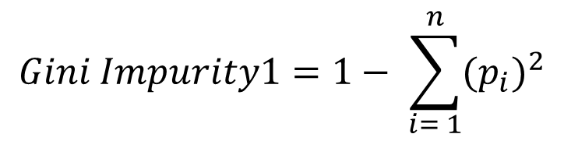
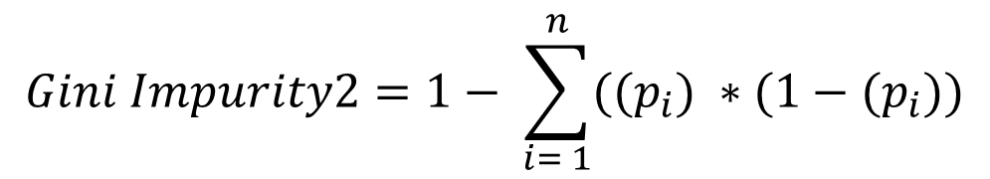
Decision Tree: Gini Index Sunny
Gini Index
Faster to compute compared to other impurity measures like entropy
More sensitive to changes in class probabilities, which can be beneficial for certain datasets
Can be biased towards attributes with more categories, which might not always be desirable
Entropy (Information Gain)
Interpretability: Provides a clear measure of the amount of information needed to classify data points, making it easier to understand the splits
Balanced Splits: Tends to produce more balanced splits compared to the Gini Index
Computationally Intensive: More complex and time-consuming to calculate than the Gini Index
$$Gini Impurity1=1− \sum_{i= 1}^{n}{{{(p}_{i})}^{2}}$$
$$Gini Impurity2=1− \sum_{i= 1}^{n}{{((p}_{i}) ∗(1−{(p}_{i}))}$$
$$Gini Index=Gini(S)−Gini Impurity(S,X)$$

Slide 21
Decision Tree: Gini Index
Sl. No. | Outlook | Temp | Humidity | Windy | Play Golf
1 | Rainy | Hot | High | Weak | No
2 | Rainy | Hot | High | Strong | No
3 | Overcast | Hot | High | Weak | Yes
4 | Sunny | Mild | High | Weak | Yes
5 | Sunny | Cool | Normal | Weak | Yes
6 | Sunny | Cool | Normal | Strong | No
7 | Overcast | Cool | Normal | Strong | Yes
8 | Rainy | Mild | High | Weak | No
9 | Rainy | Cool | Normal | Weak | Yes
10 | Sunny | Mild | Normal | Weak | Yes
11 | Rainy | Mild | Normal | Strong | Yes
12 | Overcast | Mild | High | Strong | Yes
13 | Overcast | Hot | Normal | Weak | Yes
14 | Sunny | Mild | High | Strong | No

Slide 22


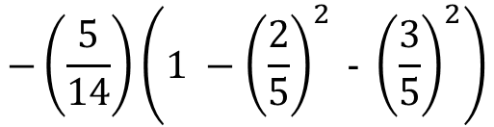
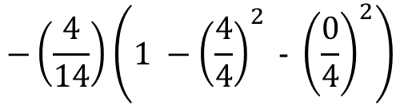
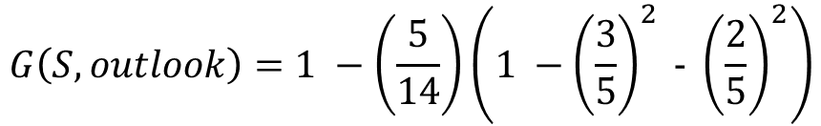
Decision Tree: Gini Index
Entropy of the Class Variable
$G\left(S\right)=1− [{\left(\frac{9}{14}\right)}^{2}$ +${\left(\frac{5}{14}\right)}^{2}]=0.4591$
$G\left(S, outlook\right)=1 −[\left(\frac{5}{14}\right)G\left(Outllook,Sunny\right)$ +$\left(\frac{4}{14}\right)G\left(Outllook,Overcast\right)$ + $\left(\frac{5}{14}\right)G\left(Outllook,Rainy\right)$]
$$G\left(S, outlook\right)=1 −\left(\frac{5}{14}\right)\left(1 −{\left(\frac{3}{5}\right)}^{2} \text{− }{\left(\frac{2}{5}\right)}^{2}\right)$$
Overcast
 | Yes | No | Count
Sunny | 3 | 2 | 5
Overcast | 4 | 0 | 4
Rainy | 2 | 3 | 5
Total | 9 | 5 | 100%
$$−\left(\frac{4}{14}\right)\left(1 −{\left(\frac{4}{4}\right)}^{2} \text{−} {\left(\frac{0}{4}\right)}^{2}\right)$$
$=0.657143$
$$−\left(\frac{5}{14}\right)\left(1 −{\left(\frac{2}{5}\right)}^{2} \text{−} {\left(\frac{3}{5}\right)}^{2}\right)$$
$$Gini Index\left(S,Outlook\right)=0.4591−0.657143=\text{−0.19804}$$

Slide 23

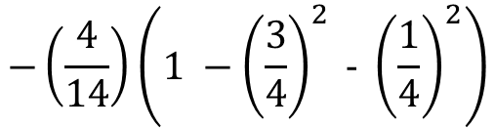
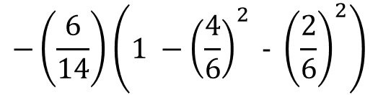
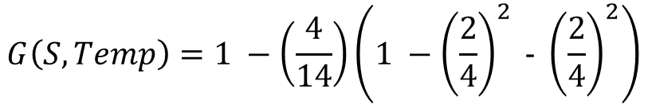
Decision Tree: Gini Index
$G\left(S, Temp\right)=1 −[\left(\frac{4}{14}\right)G\left(Temp,Hot\right)$ +$\left(\frac{6}{14}\right)G\left(Temp,Mild\right)$ + $\left(\frac{4}{14}\right)G\left(Temp,Cool\right)$]
$$G\left(S, Temp\right)=1 −\left(\frac{4}{14}\right)\left(1 −{\left(\frac{2}{4}\right)}^{2} \text{− }{\left(\frac{2}{4}\right)}^{2}\right)$$
$$−\left(\frac{6}{14}\right)\left(1 −{\left(\frac{4}{6}\right)}^{2} \text{−} {\left(\frac{2}{6}\right)}^{2}\right)$$
$$=0.559524$$
$$−\left(\frac{4}{14}\right)\left(1 −{\left(\frac{3}{4}\right)}^{2} \text{−} {\left(\frac{1}{4}\right)}^{2}\right)$$
Temperature
 | Yes | No | Count
Hot | 2 | 2 | 4
Mild | 4 | 2 | 6
Cool | 3 | 1 | 4
Total | 9 | 5 | 100%
$$Gini Index\left(S,Temp\right)=0.4591−0.559524=\text{−0.10042}$$

Slide 24


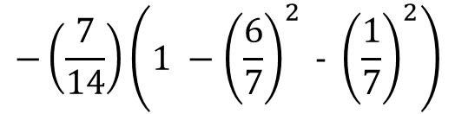
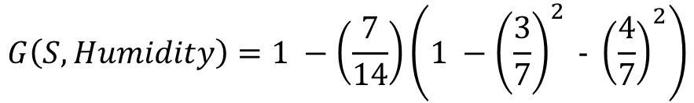
Decision Tree: Gini Index
Entropy of the Class Variable
$G\left(S\right)=1− [{\left(\frac{9}{14}\right)}^{2}$ +${\left(\frac{5}{14}\right)}^{2}]=0.4591$
$G\left(S,Humidity\right)=1 −[\left(\frac{7}{14}\right)G\left(Humidity,High\right)$ +$\left(\frac{7}{14}\right)G\left(Humidity,Normal\right)$]
$$G\left(S, Humidity\right)=1 −\left(\frac{7}{14}\right)\left(1 −{\left(\frac{3}{7}\right)}^{2} \text{− }{\left(\frac{4}{7}\right)}^{2}\right)$$
Humidity
 | Yes | No | Count
High | 3 | 4 | 7
Normal | 6 | 1 | 7
Total | 9 | 5 | 100%
$$−\left(\frac{7}{14}\right)\left(1 −{\left(\frac{6}{7}\right)}^{2} \text{−} {\left(\frac{1}{7}\right)}^{2}\right)$$
$$=\text{0.632653}$$
$Gini Index\left(S,Humidity\right)=0.4591−\text{0.632653}$ =-0.17355

Slide 25

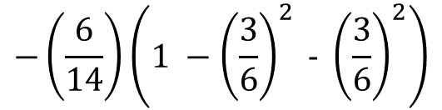
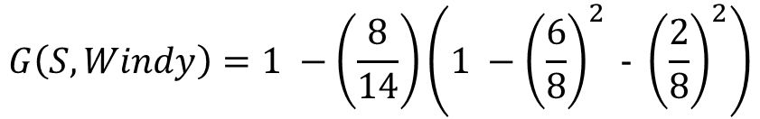
Decision Tree: Gini Index
Entropy of the Class Variable
$G\left(S\right)=1− [{\left(\frac{9}{14}\right)}^{2}$ +${\left(\frac{5}{14}\right)}^{2}]=0.4591$
$G\left(S, Windy\right)=1 −[\left(\frac{8}{14}\right)G\left(Windy,Weak\right)$ +$\left(\frac{6}{14}\right)G\left(Windy,Strong\right)$ ]
$$G\left(S,Windy\right)=1 −\left(\frac{8}{14}\right)\left(1 −{\left(\frac{6}{8}\right)}^{2} \text{− }{\left(\frac{2}{8}\right)}^{2}\right)$$
Wind
 | Yes | No | Count
Weak | 6 | 2 | 8
Strong | 3 | 3 | 6
Total | 9 | 5 | 100%
$$=−0.571429$$
$$−\left(\frac{6}{14}\right)\left(1 −{\left(\frac{3}{6}\right)}^{2} \text{−} {\left(\frac{3}{6}\right)}^{2}\right)$$
$Gini Index\left(S,Wind\right)=0.4591−0.571429$=- $0.11233$

Slide 26
Decision Tree: Gini Gain
$$Gini Index\left(S,Outlook\right)=0.4591−0.657143=\text{−0.19804}$$
$$Gini Index\left(S,Temp\right)=0.4591−0.559524=\text{−0.10042}$$
Minimum Gini Index or Maximum Gini Impurity
Should be selected as Root Node
$Gini Index\left(S,Humidity\right)=0.4591−\text{0.632653}$ =-0.17355
Outlook
$Gini Index\left(S,Wind\right)=0.4591−0.571429$=- $0.11233$
Sunny
Rainy
Yes

Slide 27
Decision Tree: Gini Index
Sunny
Sl. No. | Outlook | Temp | Humidity | Windy | Play Golf
1 | Rainy | Hot | High | Weak | No
2 | Rainy | Hot | High | Strong | No
3 | Overcast | Hot | High | Weak | Yes
4 | Sunny | Mild | High | Weak | Yes
5 | Sunny | Cool | Normal | Weak | Yes
6 | Sunny | Cool | Normal | Strong | No
7 | Overcast | Cool | Normal | Strong | Yes
8 | Rainy | Mild | High | Weak | No
9 | Rainy | Cool | Normal | Weak | Yes
10 | Sunny | Mild | Normal | Weak | Yes
11 | Rainy | Mild | Normal | Strong | Yes
12 | Overcast | Mild | High | Strong | Yes
13 | Overcast | Hot | Normal | Weak | Yes
14 | Sunny | Mild | High | Strong | No
Sl. No. | Temp | Humidity | Windy | Play Golf
1 | Mild | High | Weak | Yes
2 | Cool | Normal | Weak | Yes
3 | Cool | Normal | Strong | No
4 | Mild | Normal | Weak | Yes
5 | Mild | High | Strong | No
Rainy
Sl. No. | Temp | Humidity | Windy | Play Golf
1 | Hot | High | Weak | No
2 | Hot | High | Strong | No
3 | Mild | High | Weak | No
4 | Cool | Normal | Weak | Yes
5 | Mild | Normal | Strong | Yes

Slide 28


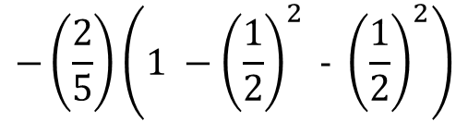
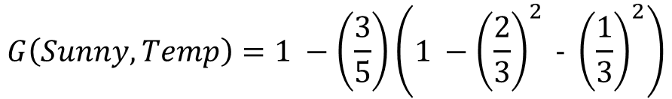
Decision Tree: Gini Index Sunny
Entropy of the Class Variable
$G\left(Sunny\right)=1− [{\left(\frac{3}{5}\right)}^{2}$ +${\left(\frac{2}{5}\right)}^{2}]=0.48$
$G\left(Sunny, Temp\right)=1 −[$+$\left(\frac{3}{5}\right)G\left(Temp,Mild\right)$ + $\left(\frac{2}{5}\right)G\left(Temp,Cool\right)$]
$$G\left(Sunny, Temp\right)=1 −\left(\frac{3}{5}\right)\left(1 −{\left(\frac{2}{3}\right)}^{2} \text{− }{\left(\frac{1}{3}\right)}^{2}\right)$$
Temperature
 | Yes | No | Count
Mild | 2 | 1 | 3
Cool | 1 | 1 | 2
Total | 3 | 2 | 100%
$$=0.5333$$
$$−\left(\frac{2}{5}\right)\left(1 −{\left(\frac{1}{2}\right)}^{2} \text{−} {\left(\frac{1}{2}\right)}^{2}\right)$$
$$Gini Gain\left(Sunny, Temp\right)=0.48 −0.5333=−0.05333$$

Slide 29

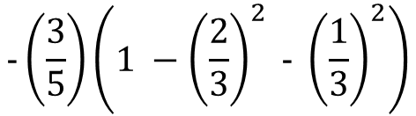
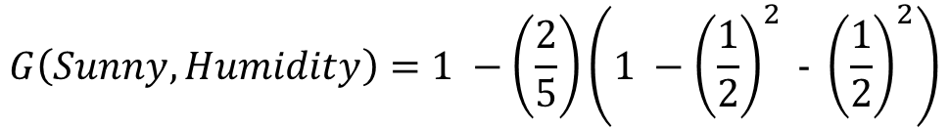
Decision Tree: Gini Index Sunny
Entropy of the Class Variable
$G\left(Sunny\right)=1− [{\left(\frac{3}{5}\right)}^{2}$ +${\left(\frac{2}{5}\right)}^{2}]=0.48$
$G\left(Sunny,Humidity\right)=1 −[\left(\frac{2}{5}\right)G\left(Humidity,High\right)$ +$\left(\frac{3}{5}\right)G\left(Humidity,Normal\right)$]
$$G\left(Sunny, Humidity\right)=1 −\left(\frac{2}{5}\right)\left(1 −{\left(\frac{1}{2}\right)}^{2} \text{− }{\left(\frac{1}{2}\right)}^{2}\right)$$
$$=0.5333$$
$$−\left(\frac{3}{5}\right)\left(1 −{\left(\frac{2}{3}\right)}^{2} \text{−} {\left(\frac{1}{3}\right)}^{2}\right)$$
Humidity
 | Yes | No | Count
High | 1 | 1 | 2
Normal | 2 | 1 | 3
Total | 3 | 2 | 100%
$$Gini Gain\left(Sunny, Humidity\right)=0.48 −0.5333=−0.05333$$

Slide 30

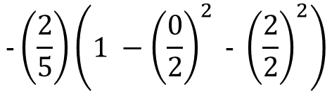

Decision Tree: Gini Index Sunny
Entropy of the Class Variable
$G\left(Sunny\right)=1− [{\left(\frac{3}{5}\right)}^{2}$ +${\left(\frac{2}{5}\right)}^{2}]=0.48$
$G\left(Sunny, Windy\right)=1 −[\left(\frac{3}{5}\right)G\left(Windy,Weak\right)$ +$\left(\frac{2}{5}\right)G\left(Windy,Strong\right)$ ]
$$G\left(Sunny,Windy\right)=1 −\left(\frac{3}{5}\right)\left(1 −{\left(\frac{3}{3}\right)}^{2} \text{− }{\left(\frac{0}{3}\right)}^{2}\right)$$
$$=1$$
$$−\left(\frac{2}{5}\right)\left(1 −{\left(\frac{0}{2}\right)}^{2} \text{−} {\left(\frac{2}{2}\right)}^{2}\right)$$
Wind
 | Yes | No | Count
Weak | 3 | 0 | 3
Strong | 0 | 2 | 2
Total | 3 | 2 | 100%
$$Gini Gain\left(Sunny, Windy\right)=0.48 −1 =−0.52$$

Slide 31
Decision Tree: Gini Index
Choose the one with highest Gini Gain
(or Lowest Gini Impurity) for root node
Outlook
$$Gini Gain\left(Sunny, Temp\right)=0.48 −0.5333=−0.05333$$
$$Gini Gain\left(Sunny, Humidity\right)=0.48 −0.5333=−0.05333$$
$$Gini Gain\left(Sunny, Windy\right)=0.48 −1 =−0.52$$
Sunny
Rainy
Windy
Yes
Weak
Strong
Yes
No

Slide 32






Decision Tree: Gini Index Rainy
Entropy of the Class Variable
$G\left(Rainy\right)=1− [{\left(\frac{2}{5}\right)}^{2}$ +${\left(\frac{3}{5}\right)}^{2}]=0.48$
$G\left(Rainy, Temp\right)=1 −[\left(\frac{2}{5}\right)G\left(Temp,Hot\right)+ \left(\frac{2}{5}\right)G\left(Temp,Mild\right)$ + $\left(\frac{1}{5}\right)G\left(Temp,Cool\right)$]
$$G\left(Rainy, Temp\right)=1 −\left(\frac{2}{5}\right)\left(1 −{\left(\frac{0}{2}\right)}^{2} \text{− }{\left(\frac{2}{2}\right)}^{2}\right)$$
Temperature
 | Yes | No | Count
Hot | 0 | 2 | 2
Mild | 1 | 1 | 2
Cool | 1 | 0 | 1
Total | 2 | 3 | 100%
$$−\left(\frac{2}{5}\right)\left(1 −{\left(\frac{1}{2}\right)}^{2} \text{−} {\left(\frac{1}{2}\right)}^{2}\right)$$
$=$ 0.8
$$−\left(\frac{1}{5}\right)\left(1 −{\left(\frac{1}{1}\right)}^{2} \text{−} {\left(\frac{0}{1}\right)}^{2}\right)$$
$Gini Gain\left(Rainy, Temp\right)=0.48 −0.8 =$ 0.32

Slide 33




Decision Tree: Gini Index Rainy
Entropy of the Class Variable
$G\left(Rainy\right)=1− [{\left(\frac{2}{5}\right)}^{2}$ +${\left(\frac{3}{5}\right)}^{2}]=0.48$
$G\left(Rainy, Humidity\right)=1 −[\left(\frac{3}{5}\right)G\left(Humidity,High\right)$ +$\left(\frac{2}{5}\right)G\left(Humidity,Normal\right)$ ]
$$G\left(Rainy,Humidity\right)=1 −\left(\frac{3}{5}\right)\left(1 −{\left(\frac{0}{3}\right)}^{2} \text{− }{\left(\frac{3}{3}\right)}^{2}\right)$$
Humidity
 | Yes | No | Count
High | 0 | 3 | 3
Normal | 2 | 0 | 2
Total | 2 | 3 | 100%
$$=1$$
$$−\left(\frac{2}{5}\right)\left(1 −{\left(\frac{2}{2}\right)}^{2} \text{−} {\left(\frac{0}{2}\right)}^{2}\right)$$
$$Gini Gain\left(Rainy,Humidity\right)=0.48 −1 =− 0.2$$

Slide 34



Decision Tree: Gini Index Rainy
Entropy of the Class Variable
$G\left(Rainy\right)=1− [{\left(\frac{2}{5}\right)}^{2}$ +${\left(\frac{3}{5}\right)}^{2}]=0.48$
$G\left(Rainy,Wind\right)=1 −[\left(\frac{3}{5}\right)G\left(Wind,Weak\right)$ +$\left(\frac{2}{5}\right)G\left(Wind,Strong\right)$]
$$G\left(Rainy,Wind\right)=1 −\left(\frac{3}{5}\right)\left(1 −{\left(\frac{1}{3}\right)}^{2} \text{− }{\left(\frac{2}{3}\right)}^{2}\right)$$
Wind
 | Yes | No | Count
Weak | 1 | 2 | 3
Strong | 1 | 1 | 2
Total | 2 | 3 | 100%
$$=0.5333$$
$$−\left(\frac{2}{5}\right)\left(1 −{\left(\frac{1}{2}\right)}^{2} \text{−} {\left(\frac{1}{2}\right)}^{2}\right)$$
$Gini Gain\left(Rainy,Wind\right)=0.48 −0.5333=$ 0.26667

Slide 35

Decision Tree: Gini Gain Rainy
Choose the one with highest Gini Gain
(or Lowest Gini Impurity) for root node
Outlook
$Gini Gain\left(Rainy, Temp\right)=0.48 −0.8 =$ 0.32
$$Gini Gain\left(Rainy,Humidity\right)=0.48 −1 =− 0.2$$
$Gini Gain\left(Rainy,Wind\right)=0.48 −0.5333=$ 0.26667
Sunny
Rain
Overcast
Windy
Humidity
Yes
Weak
Strong
Normal
High
Yes
No
Yes
No

